Slide 1

Wzzard Energy Monitoring Application

Slide 2
Introduction
The Wzzard™ Energy Monitoring Application makes it simple to see the real time and historical electrical consumption of any individual machine or panel. Data can be exported to Dropbox for further analysis.
Email or text message alerts can be sent when user-configured high or low limits are exceeded in critical applications.
Installation costs are kept low using the Wzzard wireless sensing platform.
The platform creates a self-forming, self-healing wireless mesh network that eliminates the need for wires and requires no special skills to install.
Each Wzzard sensor node is powered by long life batteries.
Using Node-RED™, a simple, browser based application preinstalled on the gateway, you can monitor current draw from any web browser on your network.

Slide 3
Access Node-Red UI in the Gateway
Attach the antenna to the Wzzard™ antenna port on the gateway.
Attach the Ethernet cable to the ETH port on the gateway and the other end to your PC.You will use an Ethernet connection to configure the gateway and to communicate with it.
Attach the supplied power supply and plug it in.
Open a browser on your computer and open the Node-RED™ configuration page. The default address is: 192.168.1.1:1880/ui. (Chrome or Firefox recommended.)
The values on this page will populate when the node joins the network.
You can set up a phone number to receive text messages, an E-Mail address for receiving alerts on this page. For text messaging, you will need to select the cell carrier of the receiving phone.
If the carrier is not on the list, select custom, and add the URL of the carrier to the phone number. If your carrier is not listed, contact your carrier for the address of their SMS gateway.
You can enable or disable alerts as well as setting the trigger values on this page also.

Slide 4
Power Up Wzzard Edge Node
Remove the (4) black screws that hold the top of the node in place.
Install your batteries Note: Use (2) 3.6V 2400 mAH Lithium Thionyl Chloride AA batteries.
Install the battery clip.
Replace the cover and tighten the (4) screws. Screws must be tightened to 5 in-lb torque in order to maintain IP66 rating. (This can be accomplished via hand tightening.)
Check LED. After you have installed the batteries, the LED will begin to blink.
This indicates that the Node is attempting to establish a network connection. The LED will cease blinking when a connection is made.
Attach the External Antenna.

Slide 5
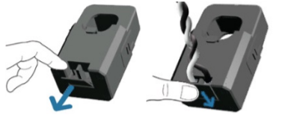
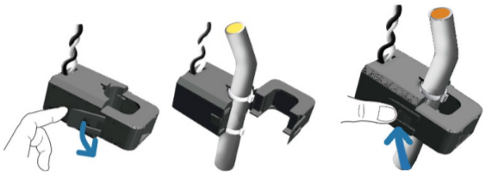
Attaching the Sensors on the Intelligent Edge Nodes
Wire Your Sensors:
Open the wire protector clamp by pushing it away from the sensor body.
Attach your wires.
Close the wire protector clamp.
Mount Your Sensors:
The sensor can be mounted in any position
Open the clamp release by pushing it away from the sensor body. Run the wire you are monitoring through the opening in the sensor.
Close the sensor firmly around your wire and ensure that the clamp release has snapped back into place.

Slide 6
Accessing the Dashboard
Open a browser on your computer and open the Node-RED™ configuration page. The default address is: 192.168.1.1:1880/ui
Click on the “Dashboard” button on the lower left corner of the configuration page.
You can switch to the Configuration page or Network Health page by clicking on their respective buttons on the upper left.

Slide 7
Setting up an E-mail Account
From your browser, open the Node-RED flow at 192.168.1.1:1880.
Find the “Send Email” node, and double click on it.
Enter The Server Address, Port, UserID and Password for your E-Mail server in the appropriate boxes. (Leave the “To” field blank.)
Click “Done”. Then Click the “Deploy” button in the upper right corner of the page.

Slide 8
Setting Up Your Dropbox For Logging
Log in to your Dropbox account or sign up for a new one.
Go to https://www.dropbox.com/developers.
Click 'Create your app' box in the centre of the screen.
Select 'Dropbox API app’.
Choose an appropriate answer as to whether your node should be limited to its own folder or given full access. (TIP: This can be changed later, so choose 'Yes' to restrict the application while testing might be a good idea.)
Choose an app name.
Click 'Create app'. The subsequent app page will contain the App key, App secret and a 'Generate' button to produce a suitable 'access token'. Save these strings so you can enter them into the application later.
From your browser, open the Node-RED™ flow at 192.168.1.1:1880.
Double click on the blue ‘Write Remote File’ node.
Then click on the pencil icon next to the Dropbox text window.
Fill in the App Key, App Secret, and Access Token you got from Dropbox in their respective fields.
Click Done, then Done again to close both windows.
Click the “Deploy” button in the upper right corner of the page.

Slide 9
License
Node-RED is licensed under the Apache License, Version 2.0
You may obtain a copy of the License at: http://www.apache.org/licenses/LICENSE-2.0

